Slide 1
A competitive strength assessment of Airlines using analysis THROUGH TWITTER DATA
BY ISHAN SUPANEKAR
READING APPENDIX IS HIGHLY RECOMMENDED TO AID PRESENTATION, DOWNLOAD LINK ON SLIDE 11

Slide 2


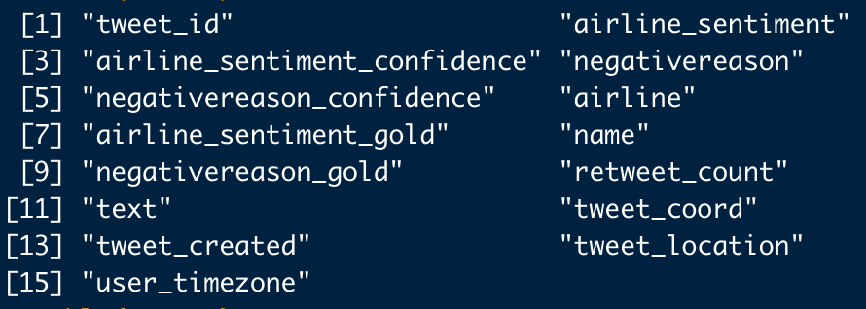
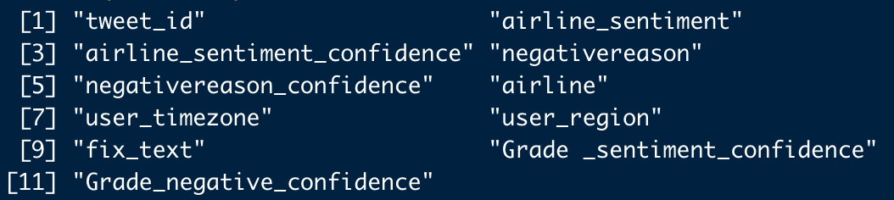
The data OVERVIEW
Original Columns Pictured Here:
Source : Twitter Sentiment Analysis
Shape of Data: 14,640 rows , 15 columns
Columns Dropped:
airline_sentiment_gold[7], name[8], negativereason_gold[9], retweet_count[10], tweet_coord[12], tweet_created[13], tweet_location[14]
Columns Substituted:
text[7] into fix_text
Columns Added:
user_region
Grade_sentiment_confidence
Grade_negative_confidence
New Shape of Data: 14,640 rows, 11 columns
New Columns Pictured Here:
*Review page 1-2 under initial observations in appendix for more insight on data impressions.*

Slide 3
Introductory statistics
Airline Sentiment:
~63% negative based tweets
~21% neutral based tweets
~16% positive based tweets
Airline Sentiment Confidence
~ 93% Confident in Negative Tweets
~ 82.3% Confident in Neutral Tweets
~ 87.2% Confident in Positive Tweets
Top 4 Negative Reason based Tweets:
1) Customer Service 31.71%
2) Late Flight 18.14%
3) Can’t tell 12.97%
4) Cancelled Flight 9.23%
Distribution of Airlines in Tweets:
United 26.11%
US Airways 19.90%
American 18.85%
Southwest 16.53%
Delta 15.18%
Virgin America 3.44%
Top 3 Airlines in proportion of negative tweets:
1) United Airlines (17.98%)
2) US Airways (15.46%)
3) American (13.39%)
Percentage of Tweets by Region of user
56.32% USA user-based tweets
32.92% of tweets did not specify location
5.1% Central American user-based tweets
*Review page 2-3 under Basic Data Interpretation in appendix for more insight on statistics in the data, as well as Excel Pivot Table Tab.*

Slide 4
Distribution of confidence levels, both sentiment categorization and negative reason categorization
Perfect, =1.0
Strong, .7<x<1
Good, .7<x<1
Perfect, =1.0
Perfect, =1.0
Weak, .3<x<.5
Unacceptable, <.3
Good, .5<x<.7
Ok, .5-.69
Weak, <.5
Perfect Confidence | x = 1
Good Confidence | .7 < x < 1
Ok Confidence | .5 < x <.7
Weak Confidence | .3 < x < .5
Unacceptable Confidence | x < .3
Perfect Confidence | x = 1
Strong Confidence | .7 < x < 1
Good Confidence | .5 < x <.7
Weak Confidence | x < .5
- I wanted to create labels for specific ranges in the confidence scores for negative reason and airline_sentiment. Used the visual portrayal of both distributions to find significant cutoffs
*Review (page 6,Figure 5) under Charts and Graphs in appendix for more insight and motivation on graph*

Slide 5
Bar charts built off created Grades of sentiment confidence and negative reason confidence
*Review (page 7,Figure 6) under Charts and Graphs in appendix for more insight and motivation on graph*

Slide 6

General Graphs about negative reason distribution and sentiment reaction with major airlines
% of Sentiment Tweets, by Airline
*Review (page 5,Figure 4) under Charts and Graphs in appendix for more insight and motivation on graph*

Slide 7
Airline global tweets data
North America dominates the regions!
*Review (page 8,Figure 7) under Charts and Graphs in appendix for more insight and motivation on graph*

Slide 8
Using analysis to score airlines(The Assessment)
 | American
Factors | Importance Weight | Strength Rating | Weighted Score
Negative Reason Complaints | 0.4 | 2 | 0.8
Market Hold | 0.2 | 3 | 0.6
Sentiment | 0.4 | 2 | 0.8
Overall Weighted Competitve Strength Rating |  |  | 2.2
 | Delta
 | Importance Weight | Strength Rating | Weighted Score
Negative Reason Complaints | 0.4 | 4 | 1.6
Market Hold | 0.2 | 2 | 0.4
Sentiment | 0.4 | 4 | 1.6
Overall Weighted Competitve Strength Rating |  |  | 3.6
 | Southwest
 | Importance Weight | Strength Rating | Weighted Score
Negative Reason Complaints | 0.4 | 3 | 1.2
Market Hold | 0.2 | 1 | 0.2
Sentiment | 0.4 | 4 | 1.6
Overall Weighted Competitve Strength Rating |  |  | 3
 | United
 | Importance Weight | Strength Rating | Weighted Score
Negative Reason Complaints | 0.4 | 5 | 2
Market Hold | 0.2 | 5 | 1
Sentiment | 0.4 | 2 | 0.8
Overall Weighted Competitve Strength Rating |  |  | 3.8
 | US Airways
 | Importance Weight | Strength Rating | Weighted Score
Negative Reason Complaints | 0.4 | 2 | 0.8
Market Hold | 0.2 | 3 | 0.6
Sentiment | 0.4 | 1 | 0.4
Overall Weighted Competitve Strength Rating |  |  | 1.8
 | Virgin America
 | Importance Weight | Strength Rating | Weighted Score
Negative Reason Complaints | 0.4 | 4 | 1.6
Market Hold | 0.2 | 2 | 0.4
Sentiment | 0.4 | 5 | 2
Overall Weighted Competitve Strength Rating |  |  | 4
Rankings of Airlines in Overall Score:
1) Virgin America - 4
2) United – 3.8
3) Delta – 3.6
4) Southwest - 3
5) American – 2.2
6) US Airways -1.8
*Review (pages 9 -15) under Airline Strength Assessment in appendix and Excel(Assessment) for more insight and methodology on table*

Slide 9
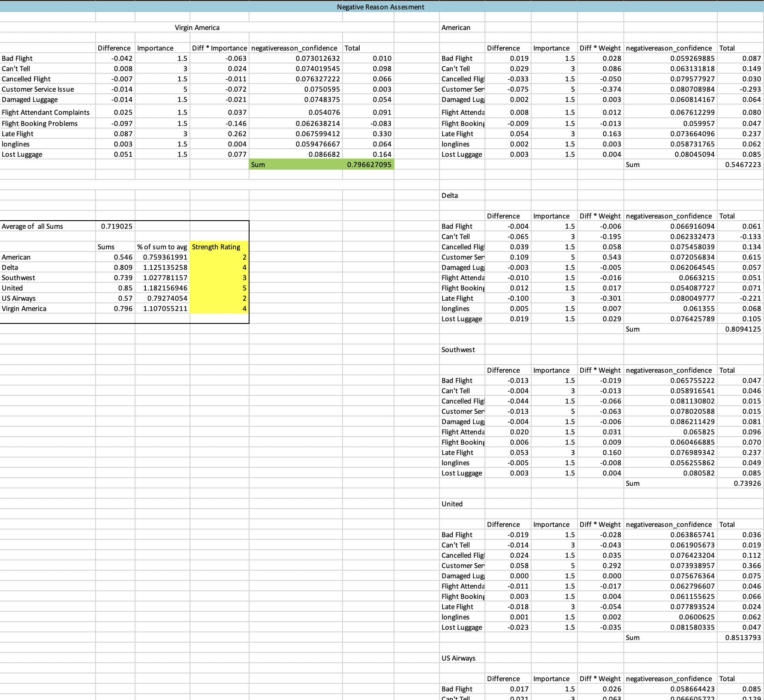
Calculations behind the strength assessment
Example table calculation for Negative Reason Assessment
Used a series of calculations based on subjective and objective thinking to create new values based on three categories: negativereason performance, user_region performance, and airline_sentiment performance
Used these values to compare each Airline, and based upon personal judgment on mathematical differences between created values, I designated strength ratings for each
*Review (pages 9 -15) under Airline Strength Assessment in appendix and Excel(Assessment) for more insight and methodology on table*

Slide 10
Takeaways
How did Virgin America score the best ?
Solid performance through all metrics
Consisted of less than ½ the rate of typical negative sentiment tweets and 2x more than the rate of typical positive sentiment tweets
Concern: Virgin only makes up 3.44% of dataset, sample size is extremely small. In future and if possible, predictions should be built with negative tweets in order to up-sample Virgin America tweet count
United Scored second best
Had by far the best metric in Market Hold (user region) due to most volume in dataset and significant presence in North America user region
Practical Use: Consulting firms can use these grades to investigate and research operations of Virgin America and United to offer best practices to other airlines
Limitations:
Since these are USA based airlines, there is a disproportionate amount of North American tweets. The Market Hold Metric would be much more effective with international airlines.
In future and if possible, predictions should be built with negative tweets in order to up sample Virgin America tweet count to validate Virgin America’s #1 ranking
*Review (pages 14 -15) under Airline Strength Assessment in appendix for further analysis and conclusion on strength assessment *

Slide 11
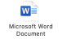
APPENDIX (Double click)

